Slide 1
Test shots
By Darius Midcalf, Alanya Sidelnik, Lyle Ingram and Justin Giddings

Slide 2
Scene 1, Shot 1, Long shot into a medium shot

Slide 3
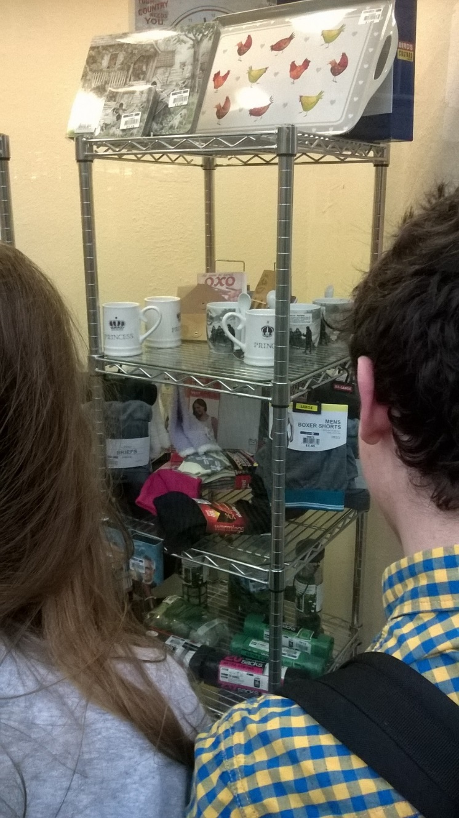
Scene 1, Shot 2, Over the shoulder shot

Slide 4
Transition 1, Fades into a blank screen which says Christmas Day while snow falls.
Christmas Day

Slide 5
Scene 2, Shot 1, Panning Shot
The shot is panning to the left

Slide 6
Scene 2, Shot 1/2 (This is gonna be a one shot thing, but we have 2 different shot types in there), Medium shot

Slide 7
Scene 2, Shot 1, Panning

Slide 8
Test footage:
Test footage of scene transaction: https://www.youtube.com/watch?v=RCzxeZQ_Vh8
Test footage of scene transaction 2: https://www.youtube.com/watch?v=n_DksgnODL8

